Slide 1
Predicting Hospital No Shows EDA | Splitting | Preprocessing
By Dennis Wang
Brown University
Presentation Slot: 10/23/24, 1:30 PM
https://github.com/dwang0120/Hospital-No-Shows

Slide 2
Sourcing the Data
Kaggle Link
100k + medical appointments in various neighborhoods in Brazil

Slide 3
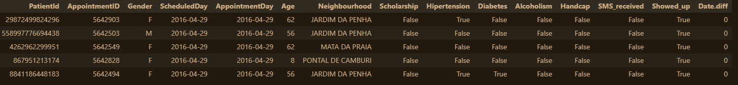
Loading in the Data (1/3)

Slide 4
Loading in the Data (2/3)

Slide 5
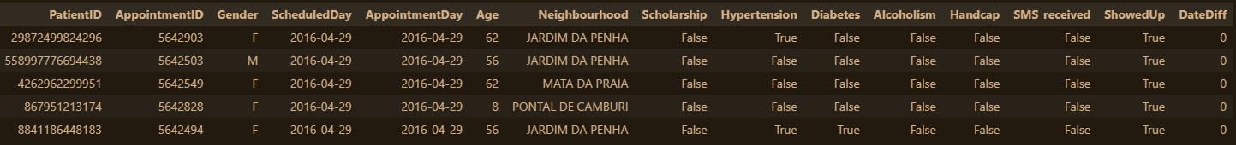
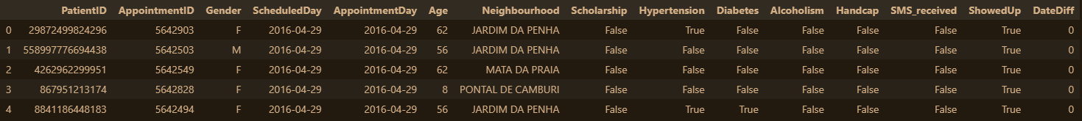
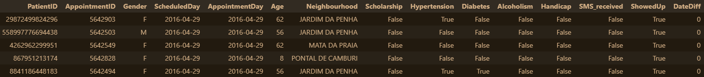
Loading in the Data (3/3)

Slide 6
Data Characteristics and Project Goal
Goal: Predicting ‘ShowedUp’ – Whether or not a patient will show up to their appointment.
Classification Problem
15 Features

Slide 7
Notable Features
PatientID – Repeated patients
Scholarship – Whether or not the patient is on Brazil’s social welfare program “Bolsa Família”
SMS_received – whether 1 or more text messages were sent to the patient
Notes:
Note: The scholarship program has strict conditions such as requiring to be vaccinated and children attending school, so it’s not strictly that the patient is of low-income. Bolsa Família - Wikipedia

Slide 8
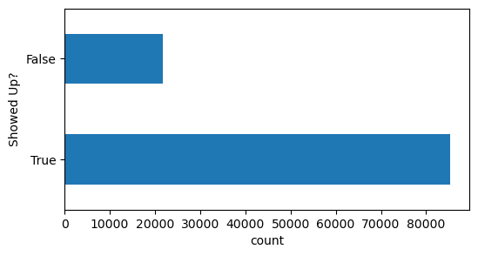
EDA (1/3) (wip)
Visualizing our target variable
It’s wildly imbalanced!

Slide 9
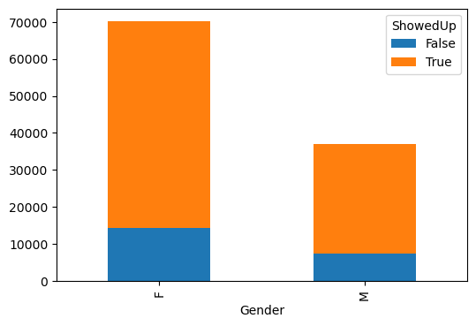
EDA (2/3) (wip)
Gender is unbalanced
Also provide a normalized plot to see if the % ShowedUp is different between genders?

Slide 10
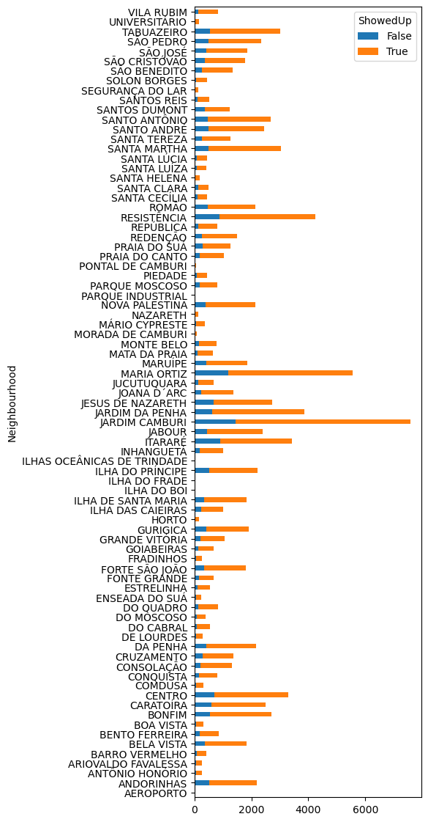
EDA (3/3) (wip)
Definitely more representation from some neighborhoods than others

Slide 11
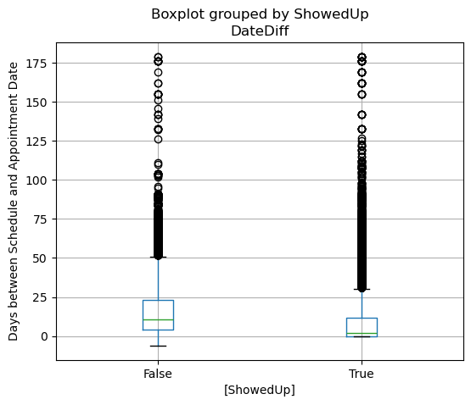
EDA (?/3) pick and choose one to replace
People who show up tend to schedule their appointments closer to the day of
Negative date diff?
Large outlier count

Slide 12
Splitting Data
Notes
Data is not iid
Target variable is unbalanced
Stratify?
Group?
Evaluation Metrics
Notes:
StratifiedGroupKFold

Slide 13
Preprocessing
To do:
Convert Gender Strings 'M' and 'F' into 0 and 1
normalize Age (MinMax Scaler)
standardize DateDiff (StandardScaler)
Figure out what to do with our non-numerical features: ScheduledDay, AppointmentDay, and Neighbourhood
One Hot Encode Neighbourhood (81 unique values)
Maybe:
Feature engineer ScheduledDay_IsSunday? ... ScheduledDay_IsSaturday? and AppointmentDay...IsSunday? etc.
or ScheduledDate_IsWeekend? ...IsWeekday? if want to be less granular
or Season?
Thoughts: Given that we have several repeated patients in our dataset, it would stand to reason that the feature values for each of their appointments are identical other than in ScheduledDay, AppointmentDay, and DateDiff. Therefore, feature engineering based on these columns could further differentiate the date?

